Slide 1
AGEISM IN THE WORKPLACE
Institution Affiliate
Student’s Name
Course title
Date.

Slide 2
AGEISM IN THE WORKPLACE
Abstract.
Age discrimination at the workplace is a concern especially for organizations that have an increasingly age-diverse workforce.
Age discrimination occurs in the form of bias regarding decision-making, evaluations and unfair behaviors during promotions, recruitment and performance appraisal.
Age discrimination in the workplace has negative outcomes for employers, employees and the relationship between employer and employee.
It is important therefore to introduce policies and intervention strategies to combat age discrimination and ageism in the workplace.
These interventions should aim at improving the employability of older employees and ban the age discrimination at workplaces.

Slide 3
Introduction
Since 1998, when the Employment Equality Act came into effect, employees and employers have been barred from discriminating against any existing or potential employees based on their age, regarding their access to or considerations for employment, promotion, training or regarding of posts.
The United States Laws prohibit any direct or indirect age discrimination and regard that the age of an employee is irrelevant (Quinn, 2010).
Direct discrimination is witnessed when an individual is treated less favourably compared to others in different age groups.
On the hand, indirect discrimination is witnessed when a practice or provision has a greater impact on individuals from one age group than it has on another. For example, various companies advertise for vacancies and indicate that the applicants should have worked in the field for more than ten years (Quinn, 2010).
The Federal Age Discrimination Act (ADEA) prohibits against age-based discrimination especially against the older age group in hiring, layoffs, firing, compensation and other factors that relate to employment (Quinn, 2010).
The law mainly is concerned with people of age 40 years and above in organizations with over twenty employees (Cleveland, 1988).

Slide 4
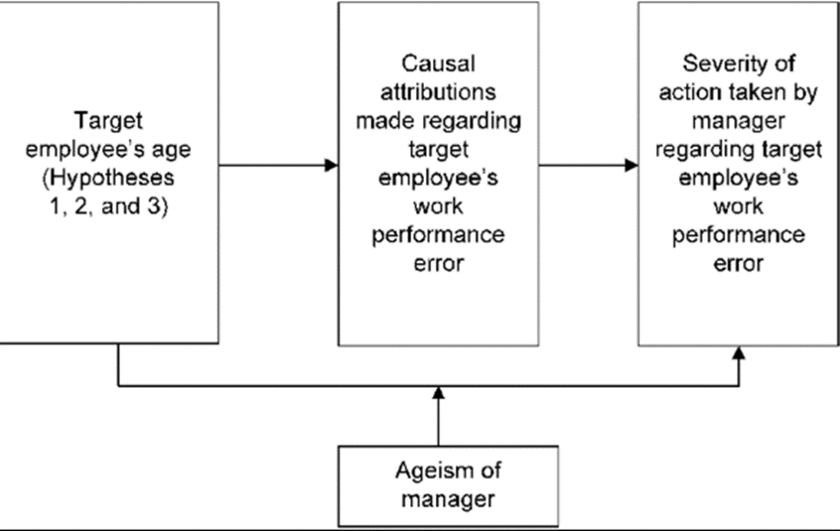
Research purpose
One major goal is to identify the legislation that governs employment, promotion, and termination of an individual as regards to age.
The text also aims at establishing the typical stereotyping of age groups in the workplaces. It has been found that many stereotypes apply mostly to young and older people.
Additionally, the article will address the aspect of retirement. Many companies have a habit of forcing their employees to retire early without even prior information (Cleveland, 1988). The theoretical model of age bias process is as shown below.

Slide 5
Cont…
As it is impossible to eradicate the age discrimination in organizations altogether, the research will determine ways in which the age discriminated people can handle the workplace prejudices.
The article also postulates on possible ways that the government can combat age perceptions in organizations which include conducting management and professional audits on hiring and publicize law suits action that counters hiring discriminations.
The research also tries to express how age biased prejudices affect the emotions of workers, which consequently, affects their productivity.
Research question
When conducting a successful survey, there is a need to develop questions regarding the topic. The survey questions may be written in the form of a questionnaire and distributed to various employees. Examples of questions that might be found are:
1. Do you believe age discrimination exists in your workplace?
2. How would you describe the performance of your older co-workers?
3. Is ageism necessary for the organization to achieve success?
4. How can ageism be prevented in an organization?

Slide 6
Hypothesis
1. To find out whether age discrimination exists in the workplace
2. To find out if ageism works better for older co-workers
3. To analyze the effects of ageism towards organizational success
4. To find out how ageism can be prevented in an organization
Research tools
Descriptive surveys and questionnaire will be used to limit biases and ensuring that all participants answer questions regarding the similar topic of study.
Data collection methods
Survey forms will be supplied to the randomly selected participants, and the reason for choosing the method is because it is inexpensive and respondents are corporative. More so, a debriefing interview will be administered to all participants to discuss the answer to survey questions.

Slide 7
Research methodology
The research methodology involved research on surveys conducted by Cleveland et al. (1988) and another by Gonzales et al., (2015) on the young people aged between 18-29 years, the middle-aged between 30- 49 and the older aged who are above 50 years old.
The surveys also took into consideration the number of hours that the individuals work weekly or daily.
Quantitative and qualitative methods were utilized in comparing the findings in all the age groups.
Analysis of limitations
Ageism is a form of employment discrimination whereby the employee or a job seeker is unfavourably treated because of the age. The aged personnel are considered posts while the young and energetic are left behind.
Some effects of ageism in the organization include;
Employers develop negative attitudes towards the younger or the older workers.
Ageism creates a less healthy working environment that is less productive in the organization
When unfair treatment of employees happen, they might feel neglected and begin to believe that they don’t have an equal opportunity in the church.
Negative attitude develop in the organization.
Ageism in the workplace interferes with teamwork.

Slide 8
Solutions
Enforcement of Anti-discrimination Laws
Banning of mandatory retirement ages
Training and development
Manager training
Promotion and new hires
Reasons why ageism has not been solved.
Private companies/organizations
Cultural believes
Action plan
The first step towards solving the problem of ageism in workplaces is to recognize the various types of ageism and what they mean in the organization.
Ageism also can be solved through education and training.

